Slide 1

ITU-ML5G-PS-001: AI/ML for 5G-Energy Consumption Modelling
JULIUS M. MAINA
Student - KCA University

Slide 2
Agenda
Introduction
Proposed solution (what is unique or new)
Results
Discussion
Conclusion
Presentation Title

Slide 3

Introduction
The 5G Revolution
5G, the fifth-generation of radio technology, is driving a profound transformation in connectivity.
It promises faster speeds, lower latency, and a plethora of new applications that will reshape industries.
A Looming Challenge
However, this revolutionary technology brings with it a significant challenge: energy consumption.
The sheer scale and complexity of 5G networks result in a substantial increase in energy usage.

Slide 4

Introduction
Understanding the Energy Puzzle
The majority of operational costs, around 25%, are allocated to energy bills.
More than 70% of this energy is consumed by base stations within the radio access network (RAN).
Optimization is Key
To mitigate this substantial energy footprint, optimizing base station parameters and energy-saving methods is paramount.
Accurate modeling of energy consumption is crucial for achieving energy-efficient network deployments.

Slide 5

THE APPROACH
-I strongly agreed with the host that this was not a time series problem. Therefore no timeseries approaches were pursued.
-Instead, of normal kfold splitting, repeated kfold seemed to work better.
- Used lightgbm after comparing its performance with other models
Advantages:
No need of tracking lag features (prone to data leaks if not carefully done), moving averages, etc
Reduced complexity - easier to understand, implement, and maintain.
Faster training and inference
Proposed solution (what is unique or new)

Slide 6
Solution Overview
Data Cleaning
Hand-Engineered Features
Train Model after 80-20 split
Performance benefited a lot from this:
Data Cleaning: Removed the 'ESMode4' column with constant zero values.
Data Harmonization: Ensured uniform antenna counts across Base Stations (BS).
Label encoded categorical features
Optimizing data for analysis by restructuring using pivoting-cellname
Total of 106 features used
Initial Meta-features all used (14) except time and esmode4
Temporal features among them hour,Day of week, Weekend etc
Active Power Saving Modes Features at a particular hour
Dummy features for RUType and mode
Domain relevant features eg.
Bandwidth_per_Antenna,
Load_to_TXpower_Ratio,
bandwidth_Load_Product,
Workload_to_Antennas_Ratio,
Xpower_Load_Interaction
LightGBM Regressor
for efficient handling of dataset size and missing values

Slide 7
Performance
Following metrics were used to track performance of the models. The training and inference was done using CPU on an 16GB RAM size computer
Accuracy: A measure of overall correctness, calculated as the ratio of correctly classified items to the total number of items in the dataset.
WMAE-based on the competition platform calculations
Training Time – time it took to train the model
Inference Time- time to predict one sample
The following parameters were considered
Objective: 'reg:squarederror' for regression tasks
Utilizes all available CPU cores with 'n_jobs: -1’
Maximum tree depth: 'max_depth: 3' (adjustable)
Learning rate: '0.1' (adjustable)
Number of boosting rounds: 'n_estimators: 10,000' for model training.

Slide 8
Performance
Metric | LightGBM KFold | Catboost KFold | XGBoost KFold | HistGradientBoosting KFold
MAE (CV for 80-20 split) | 1.0903 | 1.334 | 1.20 | 1.350
WMAE-Public | 0.0917 | 0.0989 | 0.0918 | 0.1061
WMAE-Private | 0.0906 | 0.0935 | 0.0909 | 0.099
Training Time | 355.2 Seconds | 699.98 Seconds | 780.4 Seconds | 432.4 Seconds
Inference Time | 0.001993 Seconds | 0.0025 Seconds | 0.0023 Seconds | 0.0021 Seconds

Slide 9
Performance
Metric | LightGBM KFold | LightGBM Repeated-KFold
MAE (CV for 80-20 split) | 1.0903 | 1.0692
WMAE-Public | 0.0917 | 0.0915
WMAE-Private | 0.0906 | 0.0903
Training Time | 355.2 Seconds | 1335.949 Seconds
Inference Time | 0.001993 Seconds | 0.002991 Seconds

Slide 10
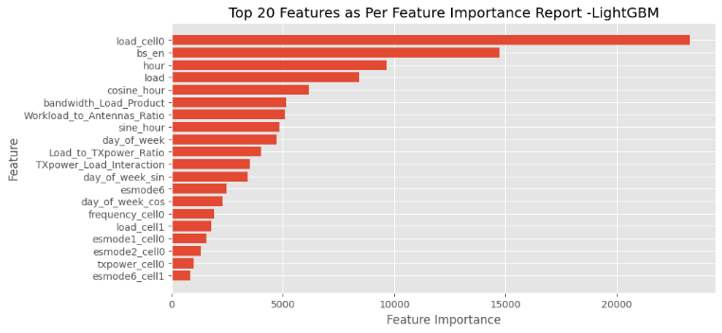

Discussion
Lightgbm generalized better than all tree based algorithms compared
Repeat-kfold generalized better than traditional kfold
Load, base station , domain depedent features and hour features among the most important features.

Slide 11

Future Work
More hyperparameter parameters for tuning
Hyperparameter Tuning: Optimize model performance through grid search or optuna
Enhanced Feature Engineering: Explore additional relevant features to enhance predictive capabilities.
Try deep learning and artificial neural networks
Ensemble predictions from more than one models

Slide 12


Conclusion
Key Points:
Valuable Dataset: Our work is empowered by a rich dataset encompassing base station configurations, network traffic, and energy consumption, providing a solid foundation for our energy consumption estimation model.
Data Preparation: Rigorous data preprocessing, cleaning, and feature engineering enhance the dataset's capacity to capture intricate patterns.
Model Selection: The LightGBM regressor is our model of choice for robust energy consumption estimation.
==> Our approach offers a promising solution for optimizing base station energy consumption, reducing operational costs, and advancing 5G network sustainability. Let's shape a more energy-efficient future for 5G together.

Slide 13
Thank you
Julius Maina
Contact: julmngii@gmail.com

